Slide 1
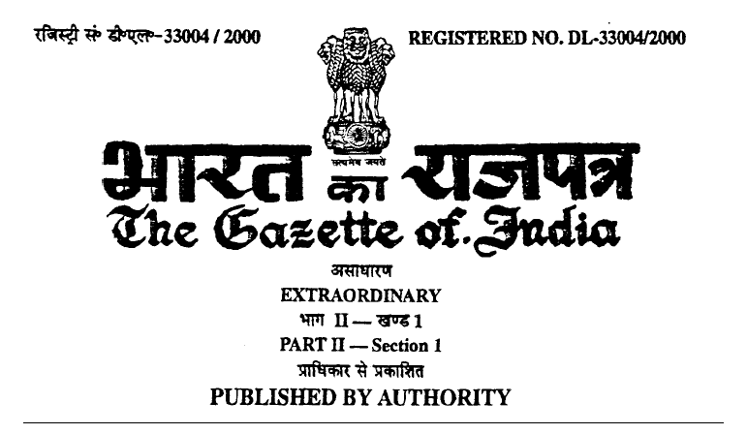
-Indian I.T Act-

Slide 2
I.T Act 2000
Indian I.T act 2000 says that An Act to provide legal recognition for transactions carried out by means of electronic data interchange and other means of electronic communication, commonly referred to as "electronic commerce", which involve the use of alternatives to paper-based methods of communication and storage of information, to facilitate electronic filing of documents with the Government agencies and further to amend the Indian Penal Code, the Indian Evidence Act, 1872, for matters connected therewith or incidental thereto.

Slide 3
I.T Act 2008 Amendment.
In 2008 Amendment Of I.T Act, Numerous Sections were added.
Addition of These Sections Made Indian IT Law one of the Best Cyber law Structure in the World.
Section 43 till section 45 including Sub-sections were added to the Original IT Act.
Similarly Section 65 to Section 75 including Sub-Sections were Added and Amended.

Slide 4
Sections Under IT act 2008
Sec 43(a):-Unauthorised Access
Sec 43(b):-Unauthorised Downloading,Copying or Extraction
Sec 43(c):-Computer Virus,Worm or Contaminant.
Sec 43(d):-Damaging a Computer.
Sec 43(e):-Disruption of Computer.
Sec 43(f):-Denial of Service.

Slide 5
Sections Under IT act 2008
Sec 43(g):-Facilitating Unauthorised Access.
Sec 43(h):-Tampering or Manipulating a System
Sec 43(i):-Destruction,Deletion or Alteration.
Sec 43(j):-Source Code Theft.
All these sections are compoundable and Penalty or Compensation is Done.
No Arrest Can Be Made.

Slide 6
Criminal Offences under I.T Act
Sec 65:-Tampering with Computer Source Documents.
Sec 66:-Computer Related Offences.
Sec 66A:-Sending Offensive Messages. (Removed)
Sec 66B:-Dishonestly Receiving Stolen System
Sec 66C:-Identity Theft.
Sec 66D:-Cheating By Personation.
Sec 66E:-Violation of Privacy.

Slide 7
Criminal Offences under I.T Act
Sec 66F:-Cyber Terrorism
Sec 67:-Transmitting Obscene Electronic Material.
Sec 67A:-Electronic Material With Sexually Explicit act.
Sec 67B:-Child Pornography.
Sec 67C:-Preserving Or Retention of Information by Intermediaries.

Slide 8
Criminal Offences under I.T Act
Sec 70:-Protected Systems
Sec 70B:-Indian CERT
Sec 72:-Breach of Confidentiality or Privacy.
All These Sections are Cognizable,Compoundable and Bailable Except Sec 66F.
Monetary Penalty or Prison Time or Both Could be Penalised if Convicted.

Slide 9
Thank You.

